Slide 1
Distributed System (BESE-VII)
Compiled by
Er. Madan Kadariya
Assistant Professor
HOD, Department of Information Technology Engineering
Nepal College of Information Technology
Balkumari, Lalitpur

Slide 2
Chapter 1: Introduction to Distributed System
References:
G. Coulouris, J. Dollimore and T. Kindberg; Distributed Systems Concepts and Design,4th Edition.
Andrew S. Tanenbaum and Maarten van Steen; Distributed Systems: Principles and Paradigms, 2nd Edition.

Slide 3
Topics
1.1. Definition, merits and demerits 1.2. Main characteristics, design goals and challenges 1.3. Models of Distributed System 1.3.1. Architectural 1.3.2. Fundamental 1.3.3. Failure Model Defining Distributed Systems Design Challenges of Distributed Systems

Slide 4
Defining Distributed Systems
Various definition of distributed systems have been given in the literature, for example: A collection of logically related data that is distributed over different processing nodes of computer network. Definition above does not provide all characteristics of distributed systems.

Slide 5
Defining Distributed Systems
It is difficult to find a definition that provides all characteristics of distributed systems. Another way is a definition that gives a loose characterization for distributed systems such as: A distributed system is a collection of independent computers that appear to the users of the system as a single computer. With any definition, sharing of resources is a main motivation for constructing distributed systems.

Slide 6
Defining Distributed Systems
We define distributed systems more precisely as : A distributed system is one in which hardware or software components located at networked computers communicate and coordinate their actions only by message passing. Definition above covers the entire range of distributed systems in which networked computers can usefully be deployed.

Slide 7
Defining Distributed Systems
Networks of computers are everywhere! Examples of networks of computers are: Mobile phone networks Corporate networks Factory networks Campus networks Home networks In-car networks On board networks in aero planes and trains

Slide 8
Defining Distributed Systems
Our definition of distributed systems has the following significant consequences: Concurrency Tasks carry out independently No global clock Tasks coordinate their actions by exchanging messages

Slide 9
Defining Distributed Systems
Independent Failures Faults in the network result in the isolation of the computers that are connected to it. Each component of the system can fail independently, leaving the others still running.

Slide 10
Defining Distributed Systems
A collection of independent computers that appears to its users as a single coherent system. One that looks like an ordinary system to its users, but runs on a set of autonomous processing elements (PEs) where each PE has a separate physical memory space and the message transmission delay is not negligible. There is close cooperation among these PEs. The system should support an arbitrary number of processes and dynamic extensions of PEs.

Slide 11
Defining Distributed Systems
Distributed Systems encounter number of terminologies: distributed, network, parallel, concurrent, and decentralized. Parallel means lockstep actions on a data set from a single thread of control. Distributed means that the cost or performance of a computation is governed by the communication of data and control. A system is centralized if its components are restricted to one site, decentralized if its components are at different sites with no or limited or close coordination When a decentralized system has no or limited coordination, it is called networked; otherwise, it is termed distributed indicating a close coordination among components at different sites.

Slide 12
Advantages of Distributed Systems over Centralized Systems
Economics: a collection of microprocessors offer a better price/performance than mainframes. Speed: A distributed system may have more total computing power than a mainframe. Ex. 10,000 CPU chips, each running at 50 MIPS(million instruction per second). Not possible to build 500,000 MIPS single processor since it would require 0.002 nsec instruction cycle. Enhanced performance through load distributing. Inherent distribution: Some applications are inherently distributed. Ex. Computerized worldwide Airline reservation, computerized banking system in which a customer can deposit/withdraw money from his/her account from any branch of the bank. Reliability: If one machine crashes, the system as a whole can still survive. Higher availability and improved reliability. Incremental growth: Computing power can be added in small increments. Modular expandability Another deriving force: the existence of large number of personal computers, the need for people to collaborate and share information.

Slide 13
Advantages of Distributed Systems over Independent PCs
Data sharing: allow many users to access to a common databases Resource Sharing: Expensive peripherals like color printers Communication: enhance human-to-human communication, e.g., email, chat Flexibility: spread the workload over the available machines

Slide 14
Disadvantages of Distributed Systems
Software: Difficult to develop software for distributed systems Network: Saturation, lossy transmissions Security: Easy access also applies to secrete data Distribution of control Hard to detect faults Administration issues Performance Interconnect & servers must scale

Slide 15
Goals of D.S.
Transparency
Openness
Reliability
Performance
Scalability

Slide 16
General Examples of Distributed Systems
Internet/Intranets/extranets Mobile networks DNS : Distributed Database system

Slide 17
Other Examples of Distributed Systems
Cluster A type of parallel or distributed processing system, which consists of a collection of interconnected stand-alone computers cooperatively working together as a single, integrated computing resource. The computers may be standard per uniprocessor or multiprocessor. A cluster can be used for providing highly scalable services such as search engines provide for users all over the Internet.

Slide 18
Other Examples of Distributed Systems
Grid A type of parallel and distributed system that enables the sharing, selection, and aggregation of geographically distributed autonomous resources dynamically at runtime depending on their availability, capability, performance, cost, and users' quality-of-service requirements.

Slide 19
Resource sharing and the Web
The World Wide Web The World Wide Web is an evolving system for publishing and accessing resources and services across the Internet. (Figure 4)

Slide 20
Resource sharing and the Web
http://www.google.com/search?q=Buyya
www.google.com
Web servers
Browsers
www.cdk3.net
http://www.cdk3.net/
www.w3c.org
File system of
http://www.w3c.org/Protocols/Activity.html
www.w3c.org
Protocols
Activity.html
Figure 4. Web servers and web browsers.

Slide 21
Design Challenges of Distributed Systems
Designers of distributed systems need to take the following challenges into account: Heterogeneity Heterogeneous components must be able to interoperate. Openness Interfaces should allow components to be added or replaced. Security The system should only be used in the way intended.

Slide 22
Design Challenges of Distributed Systems
Scalability System should work efficiently with an increasing number of users. System performance should increase with inclusion of additional resources. Failure handling Failure of a component (partial failure) should not result in failure of the whole system.

Slide 23
Design Challenges of Distributed Systems
Transparency Distribution should be hidden from the user as much as possible.

Slide 24
Heterogeneity
Heterogeneous components that must be able to interoperate, apply to all of the following: Networks Hardware architectures Operating systems Programming languages Program written by multiple programmer

Slide 25
Heterogeneity
Examples that mask differences in network, operating systems, hardware and software to provide heterogeneity are Middleware Internet protocols Mobile code

Slide 26
Heterogeneity
Middleware Middleware applies to a software layer. Middleware provides a programming abstraction. Middleware masks the heterogeneity of the underlying networks, hardware, operating systems and programming languages. The Common Object Request Broker (CORBA) is a middleware example.

Slide 27
Heterogeneity
Mobile code Mobile code is the code that can be sent from one computer to another and run at the destination. Java applets are the example of mobile codes. Virtual machine Virtual machine provides a way of making code executable on any hardware.

Slide 28
Openness
Distributed systems must be extensible. Openness of a computer system is the characteristic that determines whether the system can be extended and re-implemented in various ways.

Slide 29
Openness
The first step in openness is publishing the documentation of software components and interfaces of the components to make them available to software developers. Monolithic Kernel: systems calls are trapped and executed by the kernel. All system calls are served by the kernel, e.g., UNIX. Microkernel: provides minimal services IPC some memory management some low-level process management and scheduling low-level i/o (E.g. multiple system interfaces.)

Slide 30
Reliability
Distributed system should be more reliable than a single system. Availability: fraction of time the system is usable. Redundancy improves it. Need to maintain consistency Need to be secure Fault tolerance: need to mask failures, recover from errors.

Slide 31
Performance
Performance loss due to communication delays: fine-grain parallelism: high degree of interaction coarse-grain parallelism (Granularity is the extent to which a system is broken down into small parts, either the system itself or its description or observation) Performance loss due to making the system fault tolerant
Notes:
Coarse-grained systems consist of fewer, larger components than fine-grained systems; a coarse-grained description of a system regards large subcomponents while a fine-grained description regards smaller components of which the larger ones are composed.

Slide 32
Security
Security of a computer system is the characteristic that the resources are accessible to authorized users and used in the way they are intended. Security for information resources has three components: Confidentiality Protection against disclosure to unauthorized individual.

Slide 33
Security
Integrity Protection against alteration or corruption. Availability Protection against interference with the means to access the resources. Security Mechanisms are: Encryption Authentication Authorization

Slide 34
Security
Security Challenges have not yet been fully met are: Denial of service attack: Bombarding the service with a large number of pointless requests that the serious users are unable to use it. Security of mobile code: Mobile code needs to be handled with care. Example: Executable attachments in email.

Slide 35
Scalability
Scalable distributed systems operate effectively and efficiently at many different scales, ranging from a small Intranet to the Internet. Scalable distributed systems remain effective when there is a significant increase in the number of resources and the number of users.

Slide 36
Scalability
System should work efficiently with an increasing number of users. System performance should increase with inclusion of additional resources Techniques that require resources linearly in terms of the size of the system are not scalable. (e.g., broadcast based query won't work for large distributed systems.

Slide 37
Scalability
Challenges of designing scalable distributed systems are: Controlling the cost of physical resources Cost should linearly increase with the system size. Controlling the performance loss For example, in hierarchically structured data, search performance loss due to data growth should not be beyond O(log n), where n is the size of data.

Slide 38
Scalability
Preventing software resources running out An example is the numbers used as Internet addresses (IP)(32 bit->128-bit) Y2K like problem. Avoiding performance bottlenecks Using decentralized algorithms to avoid having performance bottlenecks. Caching and replication in Web are examples of providing scalability.

Slide 39
Failure handling
Failures in distributed systems are partial, that is some components fail while others continue to function. Techniques for dealing with failures: Detecting failures E.g. Checksums Masking failures E.g. Retransmission of corrupt messages E.g. File redundancy

Slide 40
Failure handling
Tolerating failures E.g. Exception handling E.g. Timeouts Recovery from Failure E.g. Rollback mechanisms Redundancy E.g. Redundant components

Slide 41
Concurrency
With concurrency, services and applications can be shared by clients in a distributed system. For an object to be safe in a concurrent environment, its operations must be synchronized in such a way that its data remains consistent. Concurrency can be achieved by standard techniques such as semaphores, which are used in most operating systems.

Slide 42
Transparency
Transparency is defined as the hiding of the separation of components in a distributed systems from the user and the application programmer. With transparency the system is perceived as a whole rather than a collection of independent components.

Slide 43
Transparency
Forms of transparencies: Access transparency Enables local and remote resources to be accessed using identical operations. Location transparency Enables resources to be accessed without knowledge of their physical or network location (for example, which building or IP address).

Slide 44
Transparency
Concurrency transparency Enables several processes to operate concurrently using shared resources without interference between them. Replication transparency Enables multiple instances of resources to be used to increase reliability and performance without knowledge of the replicas by users or application programmers.

Slide 45
Transparency
Failure transparency Enables the concealment of faults, allowing users and application programs to complete their tasks despite the failure of hardware or software components. Mobility transparency Allows the movement of resources and clients within a system without affecting the operation of users or programs.

Slide 46
Transparency
Performance transparency Allows the system to be reconfigured to improve performance as loads vary. Scaling transparency Allows the system and applications to expand in scale without change to the system structure or the application algorithms.

Slide 47
Transparency
The two most important transparencies are access and location transparency referred to together as network transparency. Presence or absence of network transparency most strongly affects the utilization of distributed resources.

Slide 48
Forms of Transparency in a Distributed System
Transparency | Description
Access | Hide differences in data representation and how a resource is accessed
Location | Hide where a resource is located
Migration | Hide that a resource may move to another location or is migrated to newer version
Relocation | Hide that a resource may be moved to another location while in use
Replication | Hide that a resource may be shared by several competitive users
Concurrency | Hide that a resource may be shared by several competitive users
Failure | Hide the failure and recovery of a resource
Persistence | Hide whether a (software) resource is in memory or on disk

Slide 49
Pitfalls when Developing Distributed Systems
False assumptions made by first time developer:
The network is reliable.
The network is secure.
The network is homogeneous.
The topology does not change.
Latency is zero.
Bandwidth is infinite.
Transport cost is zero.
There is one administrator.

Slide 50
True Distributed System
A distributed system with all the challenges like transparency, scalability, Dependability, Performance, and Flexibility, being solved to its full extent, is called a True Distributed System (TDS).
However, because of the different problems (like a need of new component (network), security and software complexity faced during the development of a distributed system, a TDS is virtually possible.

Slide 51
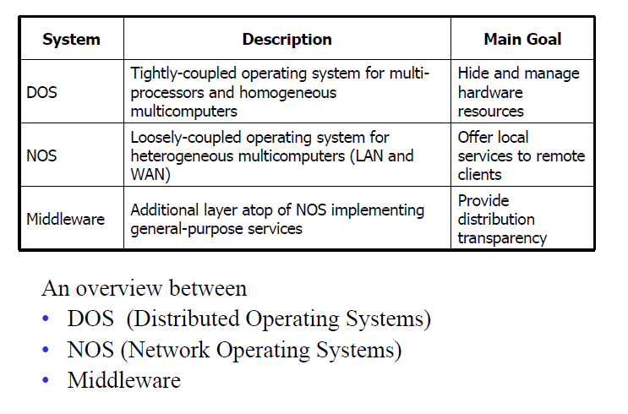
Software Concept in Distributed System

Slide 52
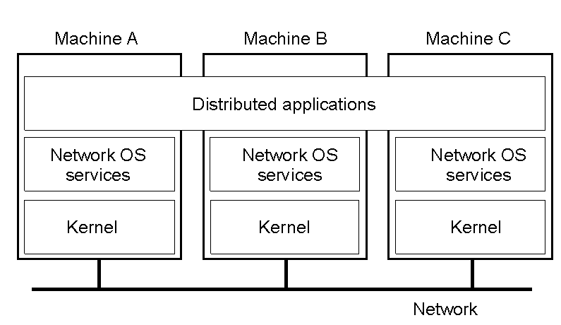
Network Operating System
Loosely-coupled operating system for heterogeneous multi-computers (LAN and WAN). Weak transparency.

Slide 53
NOS: characteristics
Network Operating System
extension of centralized operating systems
offer local services to remote clients
each processor has own operating system
user owns a machine, but can access others (e.g. rlogin, telnet)
no global naming of resources
system has little fault tolerance
e.g. UNIX, Windows NT, 2000

Slide 54

Distributed System as a Middleware Service
Additional layer on the top of NOS implementing general-purpose services. Better transparency.

Slide 55
Middleware Examples
Examples: Sun RPC, CORBA, DCOM, Java RMI (distributed object technology)
Built on top of transport layer in the ISO/OSI 7 layer reference model: application (protocol), presentation (semantic), session (dialogue), transport (e.g. TCP or UDP), network (IP, ATM etc), data link (frames, checksum), physical (bits and bytes)
Most are implemented over the internet protocols
Masks heterogeneity of underlying networks, hardware, operating system and programming languages – so provides a uniform programming model with standard services
3 types of middleware:
transaction oriented (for distributed database applications)
message oriented (for reliable asynchronous communication)
remote procedure calls (RPC) – the original OO middleware

Slide 56
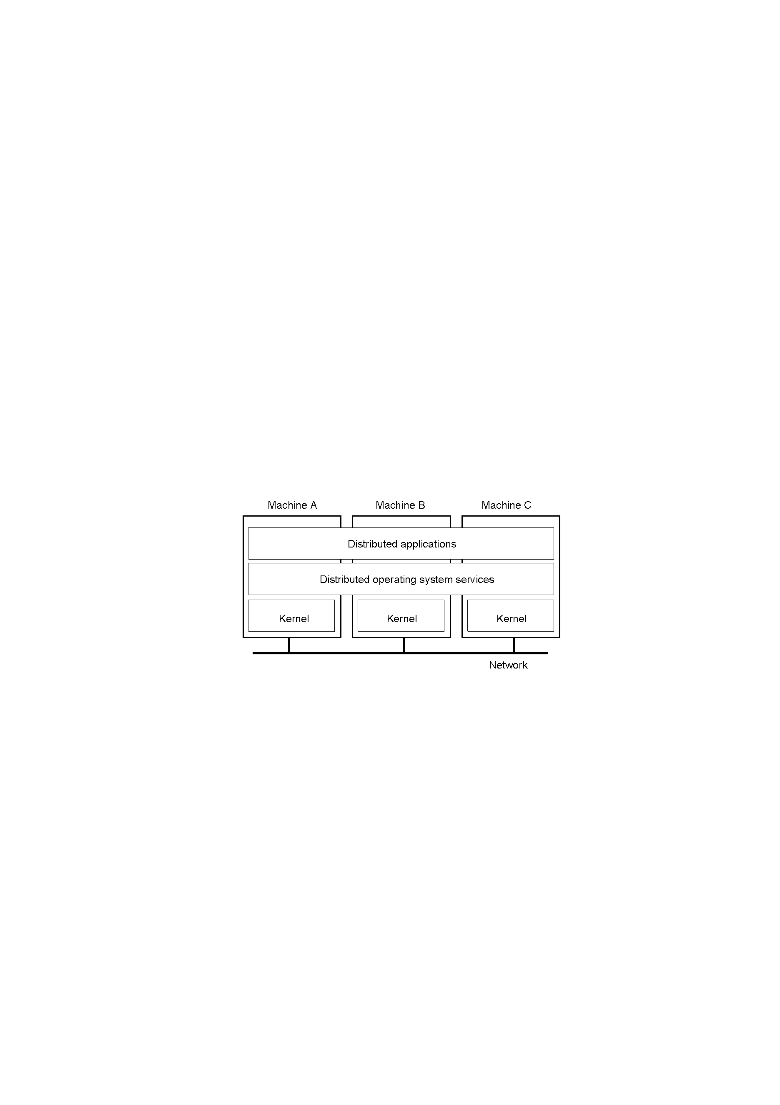
Distributed Operating System (1)
Tightly-coupled operating system for multi-processors and homogeneous multi-computers. Strong transparency.

Slide 57
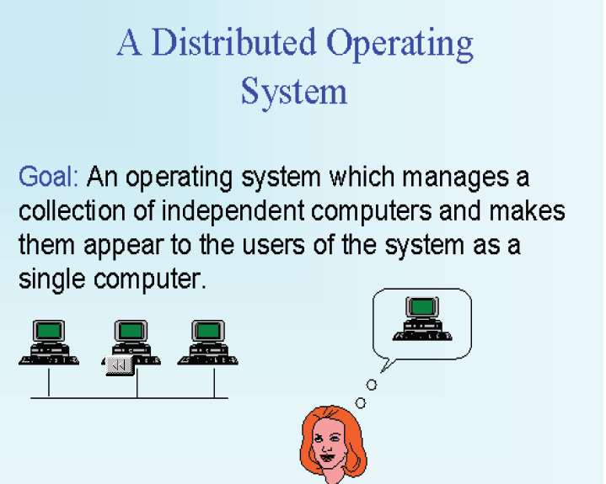
Distributed Operating System (2)

Slide 58
Distributed Operating System (3)
A distributed operating system is the logical aggregation of operating system software over a collection of independent, networked, communicating, and physically separate computational nodes (a distributed system)
Individual nodes each hold a specific software subset of the global aggregate operating system.
Each subset is a composite of two distinct service provisioners.
Kernel - that directly controls that node’s hardware.
System management components - that coordinate the node's individual and collaborative activities. These components abstract microkernel functions and support user applications.
The collection of kernel and system management components work together to make the distributed systems to appear as a single system image.

Slide 59
DOS: characteristics (1)
Distributed Operating Systems
Allows a multiprocessor or multicomputer network resources to be integrated as a single system image
Hide and manage hardware and software resources
provides transparency support
provide heterogeneity support
control network in most effective way
consists of low level commands + local operating systems + distributed features
Inter-process communication (IPC)

Slide 60
DOS: characteristics (2)
remote file and device access
global addressing and naming
trading and naming services
synchronization and deadlock avoidance
resource allocation and protection
global resource sharing
deadlock avoidance
communication security
no examples in general use but many research systems: Amoeba, Chorus etc. see Google “distributed systems research”

Slide 61
OS vs DOS
OS
DOS
Manages the local resources to serve the local user
Manages the global resources (systems connected in a distributed network) and integrates them in such a way that all the systems acts as a single coherent system.

Slide 62
NOS vs DOS
Networking operating system (NOS) also referred to as the Dialogue.
Network OS does not reside on every computer, the client only has enough software to boot the hardware and contact the server. All the subsequent operations are done on the server, and the only role of the client is to relay the input and output between the server and the user. Thus, network OS cannot handle computation intensive programs due to the stress it puts in the server.
NOS are loosely coupled operating system for heterogeneous multi-computers (LAN & WAN) whose main goal is offer the local services to remote client.
Distributed operating system (DOS) also referred to as the Middleware.
DOS is a middleware shared on all system that knows which computers are overloaded and which ones are idle. It would then balance the tasks available so that each computer in the group is sharing equal load. Relatively less hardware and the software resources are required on the user terminals.
DOS is tightly-coupled operating system for multi-processors and homogenous multi-computers whose main goal is hide & manage hardware resources.
NOS
DOS

Slide 63
Hardware Concepts

Slide 64
Multiprocessors
Multiprocessor is the use of two or more central processing units (CPUs) within a single computer system – MIMD
The term also refers to the ability of a system to support more than one processor and/or the ability to allocate tasks between them
The term multiprocessing may be sometimes used an analogous to multitasking, or multiprogramming
Distributed Systems

Slide 65
Multiprocessing Systems
Generally accepted definition of a
multiprocessing/multicomputer system:
Multiple processors, each with its own CPU
and Memory.
Interconnection hardware
Processors fail independently
There exists a shared state
Appears to users as single system

Slide 66
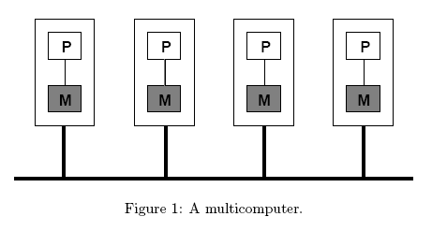
Multicomputer
A multicomputer consists of separate computing nodes connected to each other over a network
Multicomputer generally differ from each other in three ways:
Node resources: processor, memory
Network connection: star, ring etc.
Homogeneity: same nodes with same physical architecture (processor, system bus, memory)

Slide 67
Flynn’s Classification – Processor architectures
Flynn, 1966+1972 classification of computer systems in terms of instruction and data stream organizations
Based on Von-Neumann model (separate processor and memory units
4 machine organizations
SISD - Single Instruction, Single Data
SIMD - Single Instruction, Multiple Data
MISD - Multiple Instruction, Single Data
MIMD - Multiple Instruction, Multiple Data

Slide 68
Flynn Architectures (1)
CU
I
PU
D
Serial Processor (8080,M6800,i8080)
SISD
D₁
Array Processor (Supercomputers, ICL DAP, Thinking Machine CM-1 and CM-2)
PU₁
I
CU
D_{n}
PU_{n}
SIMD
CU – control unit
PU – processor unit
I – instruction stream
D – data stream

Slide 69
Flynn Architectures (2)
I1
D₁
CU₁
PU₁
Multiprocesor (All Distributed systems)
In
D_{n}
CU_{n}
PU_{n}
MIMD
I₁
CU₁
PU₁
No real examples
- possibly some pipeline architectures (Cray-1, CDC cyber 205, PIC18)
D
I_{n}
CU_{n}
PU_{n}
MISD

Slide 70
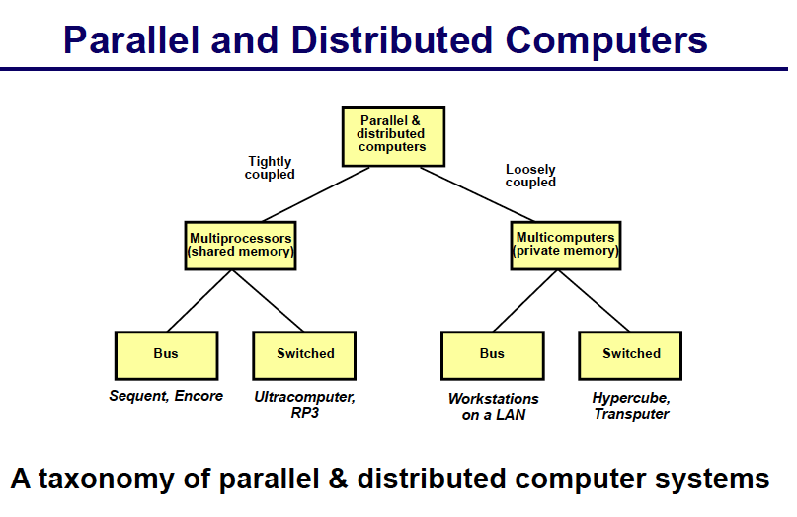

Slide 71
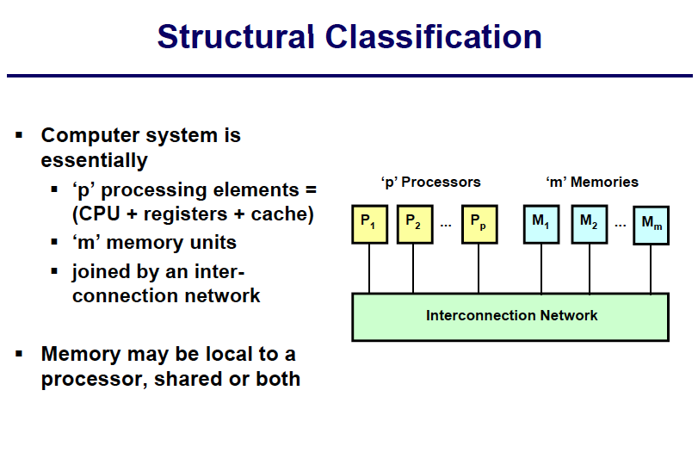

Slide 72
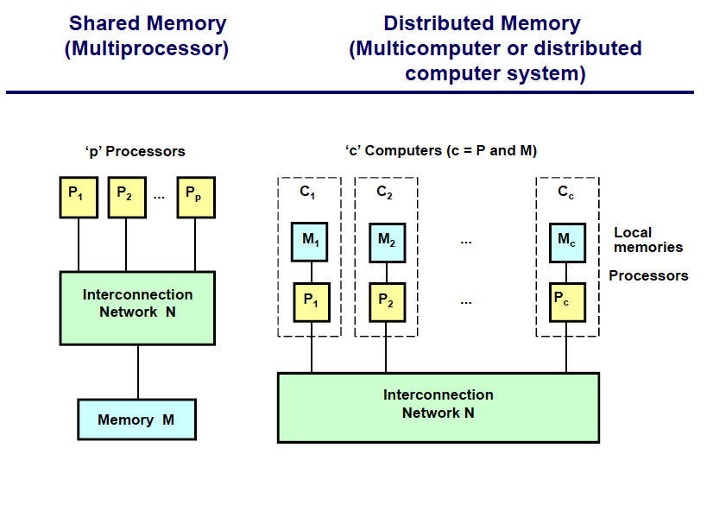

Slide 73
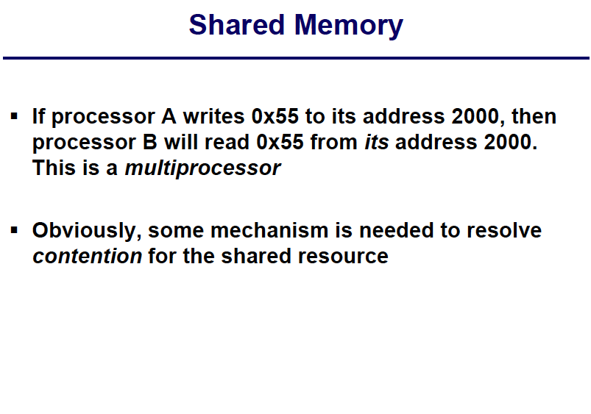

Slide 74
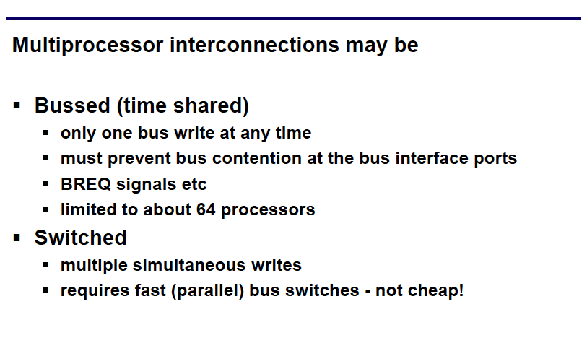
Processor-Memory Interconnection Network

Slide 75
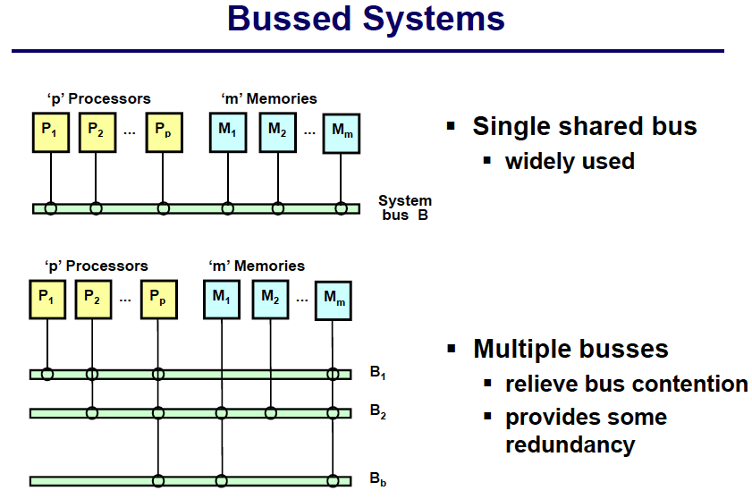
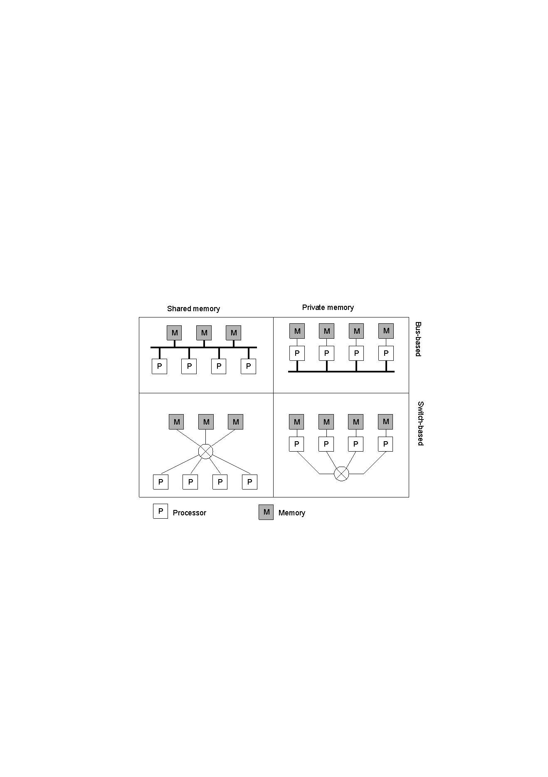

Slide 76
Bus Based Multiprocessor System
Drawback:
As few as 4 or 5 CPUs, the bus will be overloaded.
Solution: Cache memory.
Problem with cache: Incoherent.
Solution to incoherent: snoopy write through cache.
Write through: Whenever a word is written to the cache, it is written through to memory as well.
Snoopy cache: a cache is always“snooping”on the bus. Whenever it sees a write occurring to a memory address present in its cache, it either invalids the entry or updates it.

Slide 77
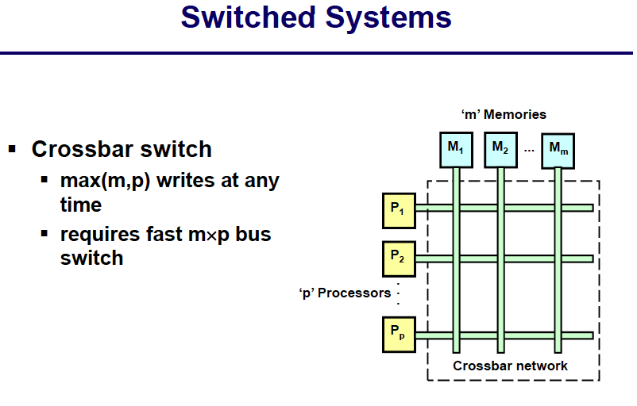
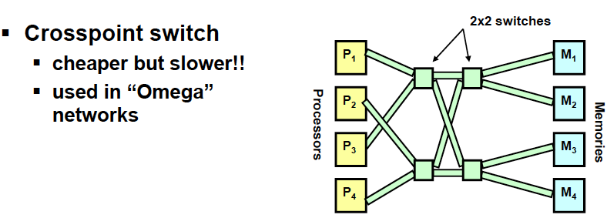

Slide 78
Cross switch
Advantage:
Many CPUs can be accessing memory at the same time.
Disadvantage:
Need n² crosspoints switches with n CPUs and n memories.
One solution: use omega network.

Slide 79
Omega network
With n CPUs and n memories, it requires log₂n switching stages, each containing n/2 switches, for a total of (n log₂n)/2 switches.
Better than crossbar switch, but still big.
Another drawback: delay (due to the number of stages).

Slide 80
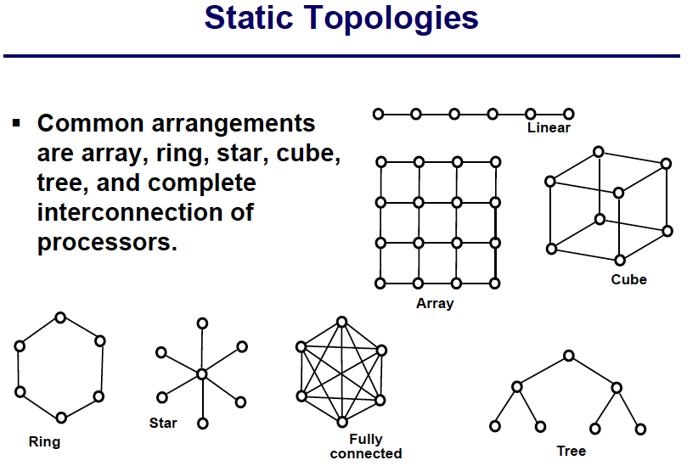
Interconnections (topology) may be either
Static – fixed by hardware
Dynamic – re-configurable in software, perhaps even during program execution
Cube (or hypercube) gives good balance between
internode length (communications latency)
number of neighbouring nodes (cost of switching circuitry).

Slide 81
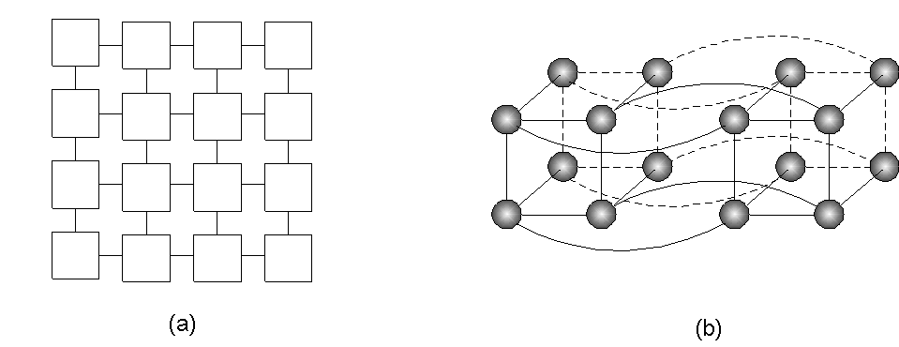
Homogeneous Multicomputer Systems – Processor Arrays
Grid
Hypercube

Slide 82
Multiprocessors or Multicomputer Coupling
Loosely Coupled
Each processor or computer having a separate memory
Tightly Coupled
Each processor or computer sharing a common memory
Processors may have separate memory units along with a shared memory

Slide 83
Loosely coupled multi-computer systems
network
M
P
M
P
M
P
Loosely-coupled multiprocessor systems (often referred to as clusters) are based on multiple standalone single or dual processor computers interconnected via a high speed communication system
A Linux Beowulf cluster is an example of a loosely-coupled system.
Distributed Memory Multi-computer or multiprocessor
IPC by message passing
Typically PC or workstation clusters
Physically distributed components
Characterized by longer message delays and limited bandwidth

Slide 84
Closely (Tightly) coupled multi-computer systems
Shared Memory
M
P
M
P
M
P
M
P
I/O
Tightly-coupled multiprocessor systems contain multiple CPUs that are connected at the bus level.
E.g. Chip multiprocessors, also known as multi-core computing, involves more than one processor placed on a single chip and can be thought of the most extreme form of tightly-coupled multiprocessing
These CPUs may have access to a central shared memory (SMP or UMA), or may participate in a memory hierarchy with both local and shared memory (NUMA).
IPC via Shared Memory

Slide 85
Tightly Coupled vs Loosely Coupled
Performance: Tightly-coupled systems perform better
Size: Tightly-coupled systems are physically smaller than loosely-coupled systems
Cost: Nodes in a loosely-coupled system are usually inexpensive than a tightly coupled system
Power consumption: Tightly-coupled systems tend to be much more energy efficient than clusters.

Slide 86
Enslow’s Model of DS
Enslow (Scientist) proposed that distributed systems can be examined using three dimensions of hardware, control, and data.
Distributed system = distributed hardware + distributed control + distributed data

Slide 87
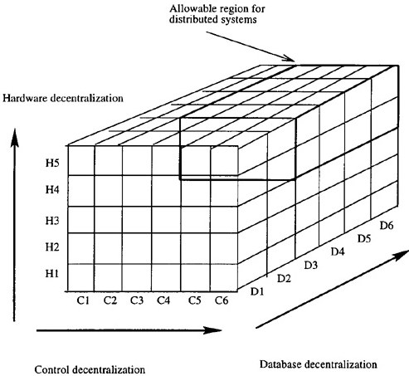
Enslow’s model of distributed systems
(Some researchers also considered computer networks and
parallel computers as part of distributed system)

Slide 88
a system can be classified as a distributed system if all three categories (hardware, control, and data) reach a certain degree of decentralization.
Several points in the dimension of hardware organization are as follows:
H1. A single CPU with one control unit.
H2. A single CPU with multiple ALUs (arithmetic and logic units). There is only one control unit

Slide 89
H3. Separate specialized functional units, such as one CPU with one floating-point coprocessor.
H4. Multiprocessors with multiple CPUs but only one single I/O system and one global memory.
H5. Multicomputers with multiple CPUs, multiple I/O systems and local memories.
Similarly, points in the control dimension in order of increasing decentralization are the following:
C1. Single fixed control point. Note that physically the system may or may not have multiple CPUs.

Slide 90
C2. Single dynamic control point. In multiple CPU cases the controller changes from time to time among CPUs.
C3. A fixed master/slave structure. For example, in a system with one CPU and one coprocessor, the CPU is a fixed master and the coprocessor is a fixed slave.
C4. A dynamic master/slave structure. The role of master/slave is modifiable by software.
C5. Multiple homogeneous control points where copies of the same controller are used.
C6. Multiple heterogeneous control points where different controllers are used

Slide 91
The database has two components that can be distributed: files and a directory that keeps track of these files
Distribution can be done in one of two ways, or a combination of both: replication and partition
A database is partitioned if it is split into sub-databases and then each sub-database is assigned to different sites

Slide 92
D1. Centralized databases with a single copy of both files and directory.
D2. Distributed files with a single centralized directory and no local directory.
D3. Replicated database with a copy of files and a directory at each site.
D4. Partitioned database with a master that keeps a complete duplicate copy of all files.
D5. Partitioned database with a master that keeps only a complete directory.
D6. Partitioned database with no master file or directory.

Slide 93
A system is a distributed one if it has:
Multiple processing elements (PEs).
Interconnection hardware.
Shared states.

